Slide 1

Lost Astronaut

Slide 2
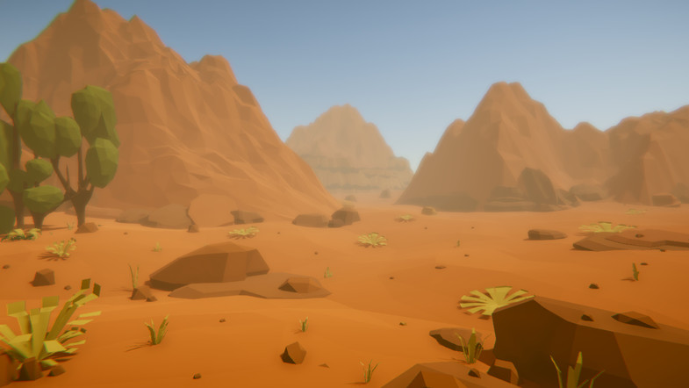
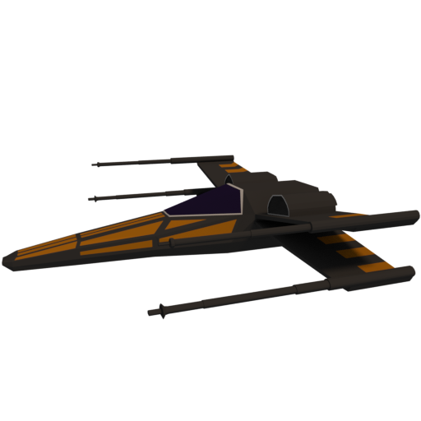
STORY

Slide 3
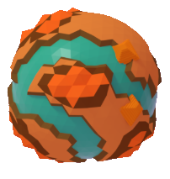
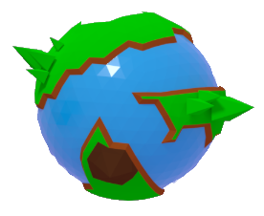
PLANETS

Slide 4


3D ADVENTURE GAME
Help this little astronaut to gather all pieces to repair his ship
Monitor your oxygen level or you will have to start all over again.

Slide 5







CONTROLS
Movement
Jump
Pause
Inventory

Slide 6





FEATURES
Pause Menu
Inventory Menu
Collectibles items : key, powers-up, etc..
Moving Enemies
Beautiful environments

Slide 7
Thank You

